Slide 1

Object Oriented Programming HTML5 Tutorials Tutorial #3 : Create an object
Department of Computer Science and Information Engineering
Shuo-Han Chen (陳碩漢), shchen@csie.ntut.edu.tw
Hong-Yue Technology Research Building 1223
F 09:10 - 12:00
Notes:
Good Afternoon everyone
I am Shuo-Han Chen, a postdoctoral research fellow at Academia Sinica
It is a great honor to be invited by the department for being here today

Slide 2

HTML5 Game Framework 使用說明
Tutorial 3: 將圖片與動作製成物件
Notes:
Thank you for listening. Now, I would like to end today’s talk by the Q & A time.

Slide 3
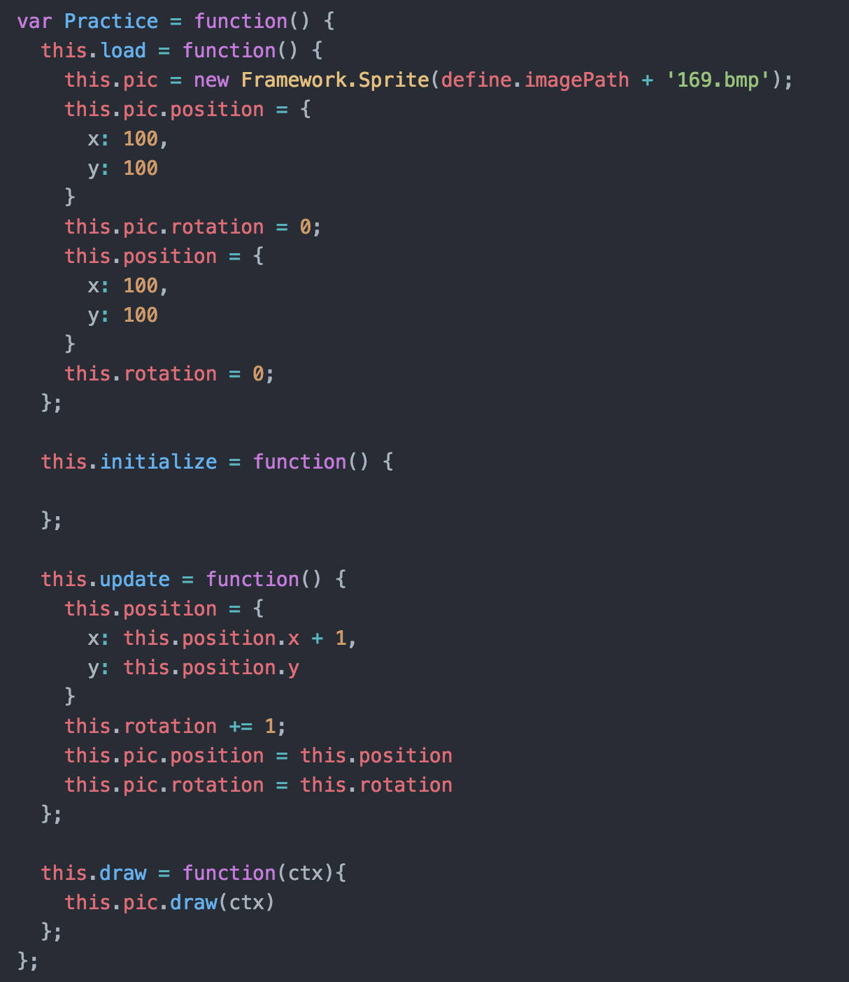
1.請先完成 Tutorial 2
2.在 OOPLab_Sample\game_sample\js 下新增一個 js 檔，命名為
Practice，並且實作 load, initialize, update 跟 draw

Slide 4
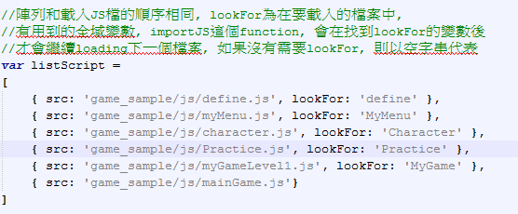


3.在 loadGame.js中加入 Practice.js
4.在 myGameLevel1.js load function宣告 Practice物件
update function增加 practice.update()

Slide 5
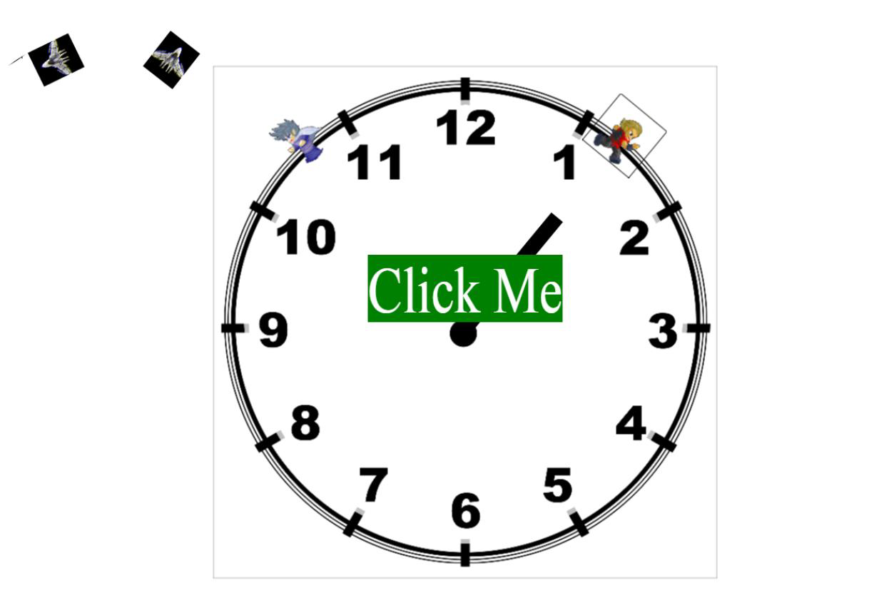
5.執行結果

